Slide 1
How old are you?
What’s that?
What’s your name?

Slide 2
Come here.

Slide 3
Go back to your seat.

Slide 4
Raise your hand.

Slide 5
Put down your hand.

Slide 6
Take out your pencil.

Slide 7
Put away your book.

Slide 8
Open your book.

Slide 9
Close your book.

Slide 11
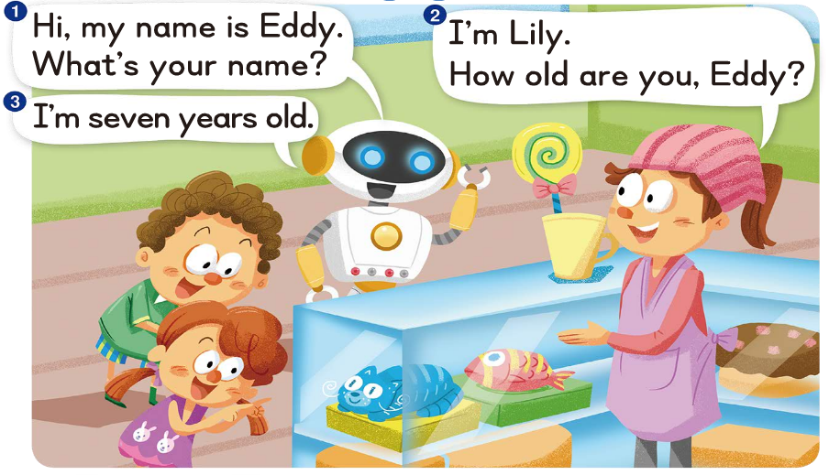

Slide 12
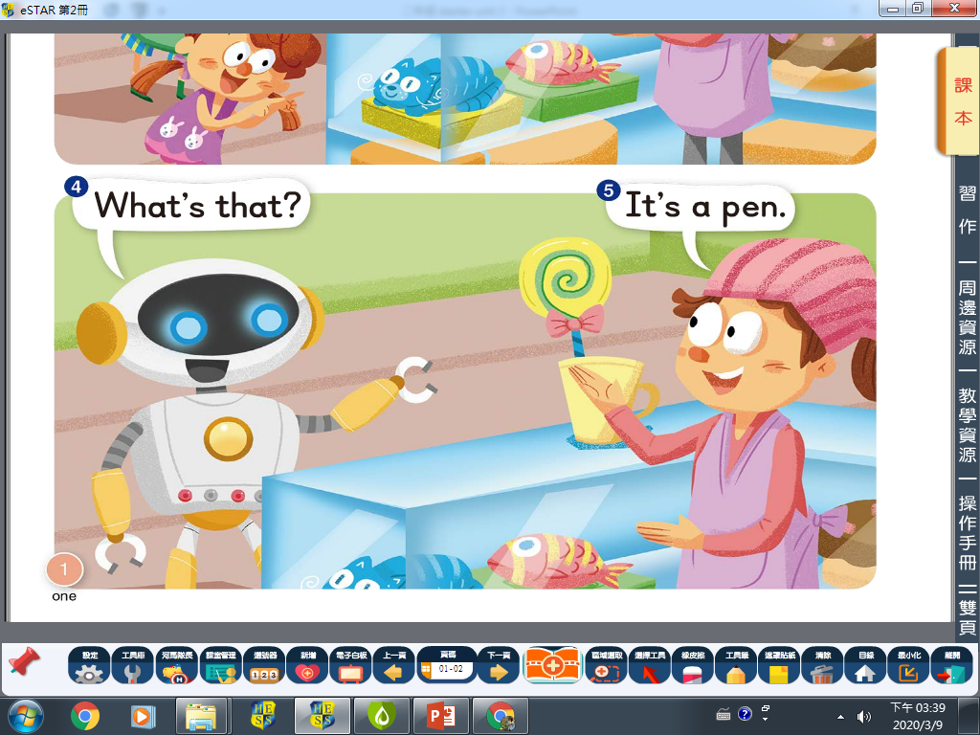

Slide 13
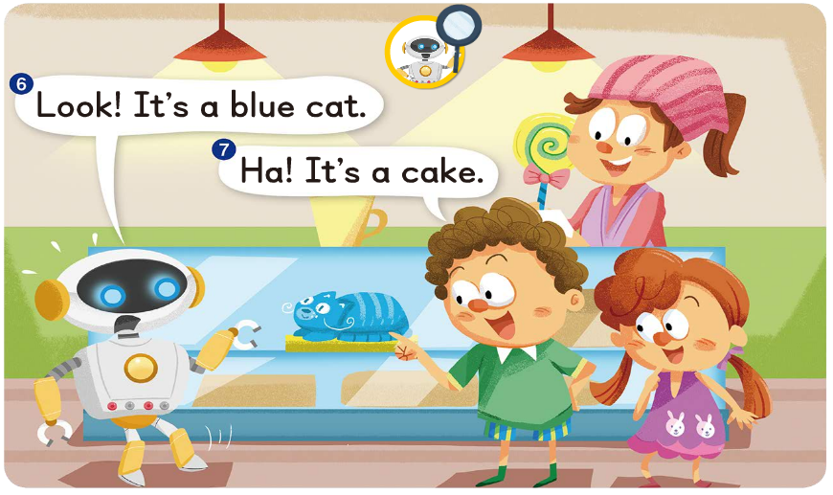

Slide 14
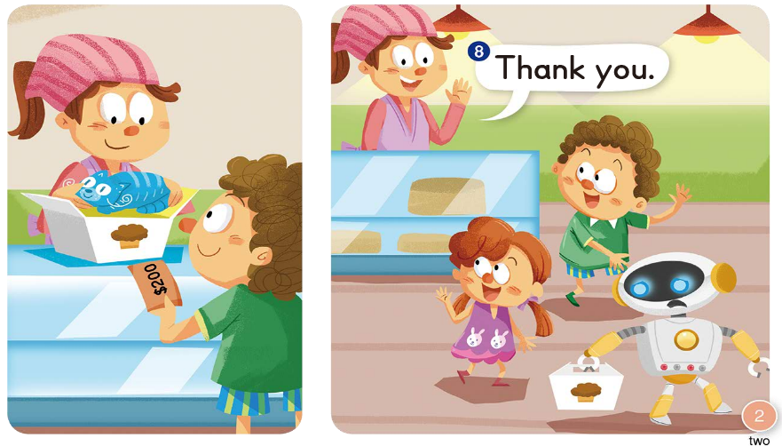

Slide 16
-ad
-at

Slide 18
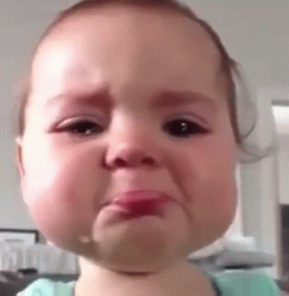
s
ad

Slide 19
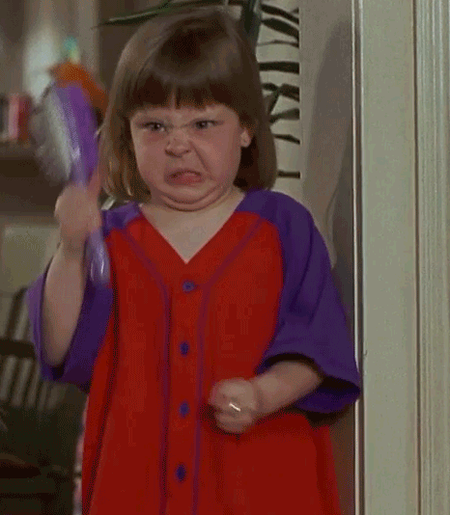
m
ad

Slide 20
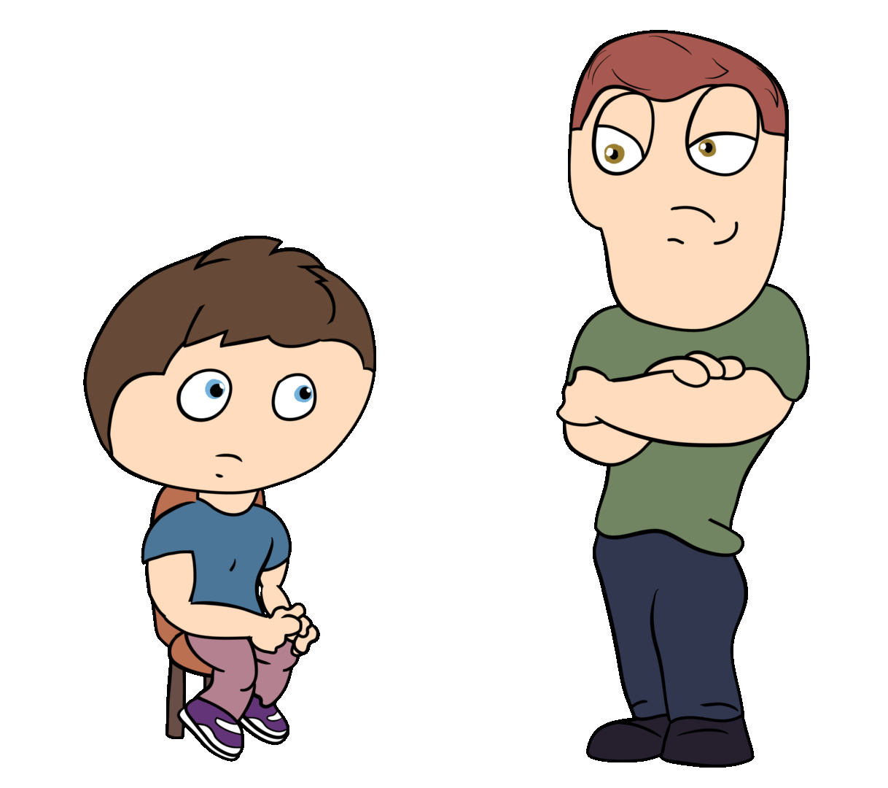
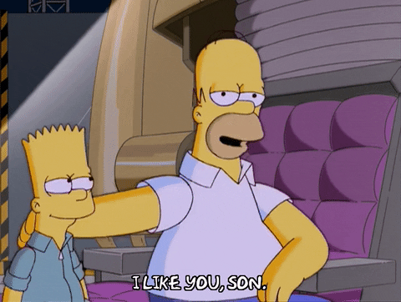
d
ad

Slide 22
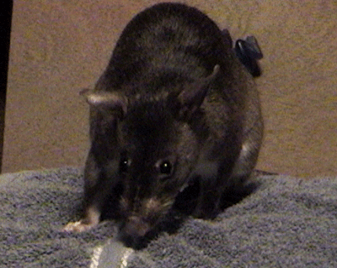
r
at

Slide 23
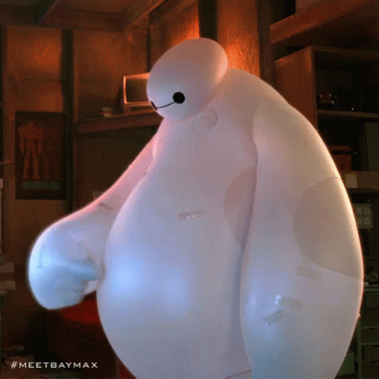
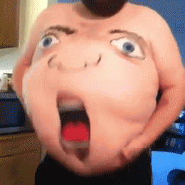
f
at

Slide 24
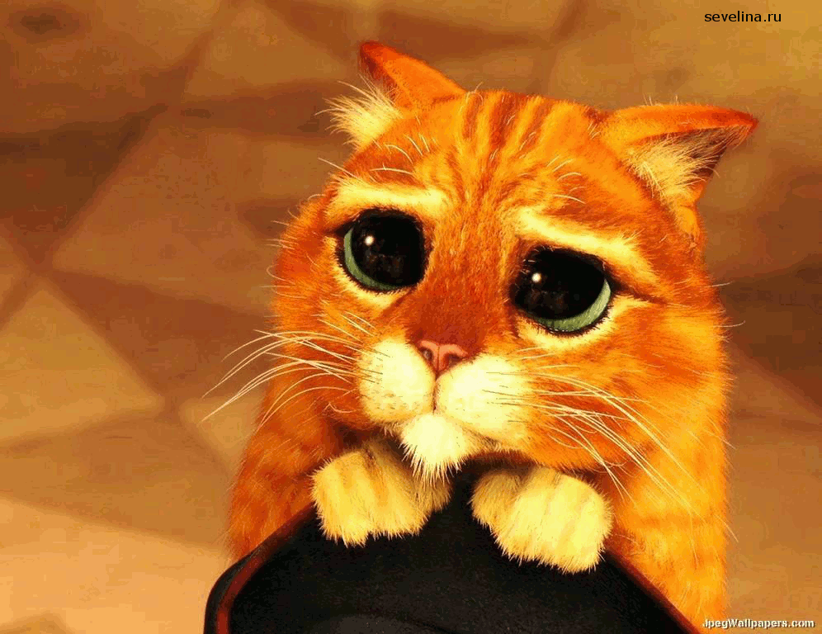
c
at

Slide 25
ad
at
sad
mad
dad
rat
fat
cat

Slide 26
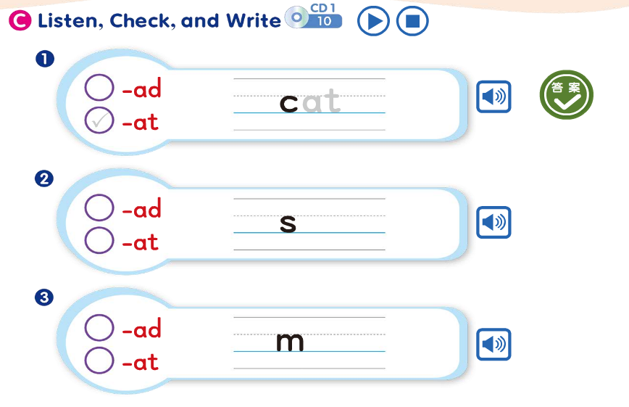

Slide 27
The cat is sad.

Slide 28
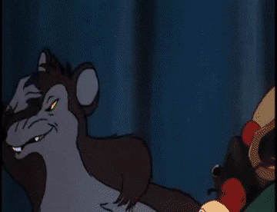
The rat is fat.

Slide 29
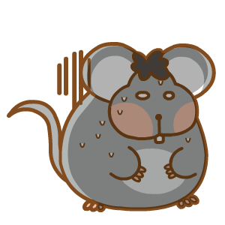
The sad cat is mad at the fat rat.

Slide 30
The cat is sad.
The rat is fat.
The sad cat is mad at the fat rat.

Slide 31
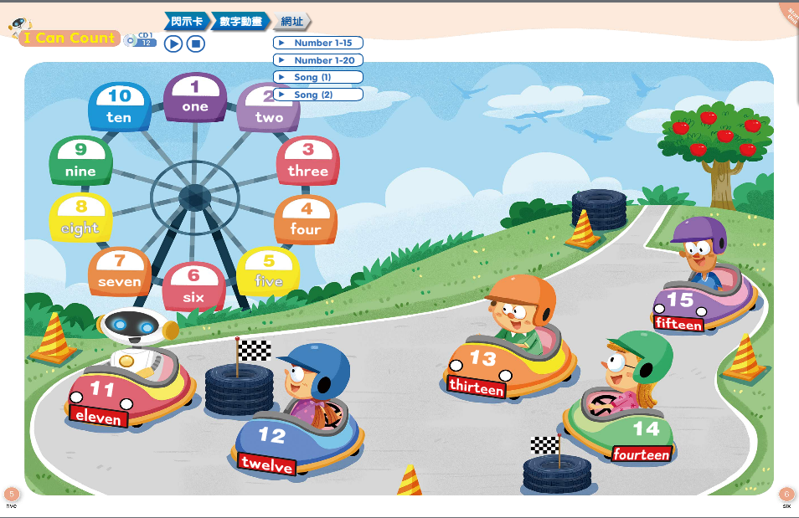

Slide 32
Homework this week
聽: CD1第5-12首。
說&讀:聽CD時跟著大聲唸。完成3遍
請家長在課本P6簽名，可換印章。
寫:完成學習單，明天交。

Slide 33
